Slide 1
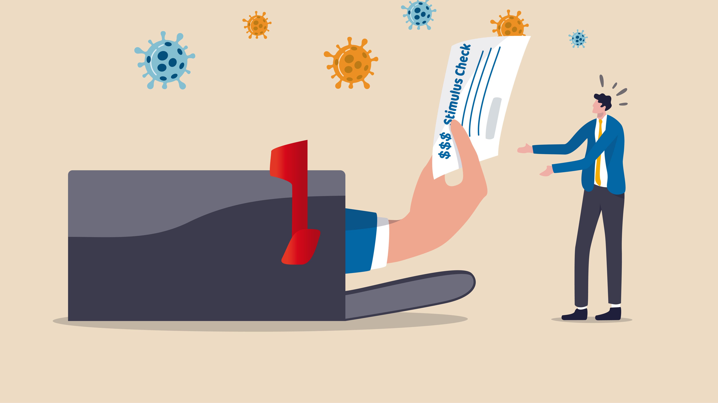
COVID-19 Stimulus Checks and their Impact on CPI
Qiaojuan Tu, Siting Liu, Mark Kelly
Dec 9th, 2021

Slide 2
Background
Name | Date | Amount of Payment
The Coronavirus Aid, Relief, and Economic Security (CARES Act) | March 27, 2020 | $1200 per adult $500 per child
The Tax Relief Act | December 27, 2020 | $600 per adult $600 per child
The American Rescue Plan | January 14, 2021 | $1400 per adult $1400 per child
Round 1
Round 2
Round 3

Slide 3
Research Questions
Question 1: Does price of goods shows abnormal increase during the COVID-19 pandemic periods?
Question 2: How does Economic Relief Payments during the COVID-19 pandemic impact the price of normal* goods?
*Normal goods: have a positive correlation between income and demand.

Slide 4
Statistical Questions
Question 1: Does CPI change more over the COVID-19 pandemic periods? If so, how much?
Question 2: Does issuance of Economic Relief Payments over the COVID-19 pandemic period have a significant impact on the price of goods?

Slide 5
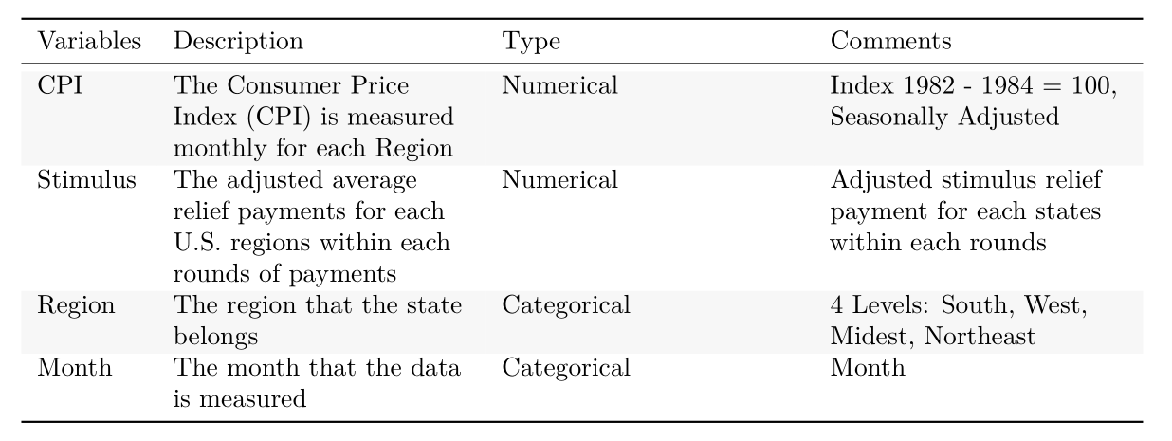
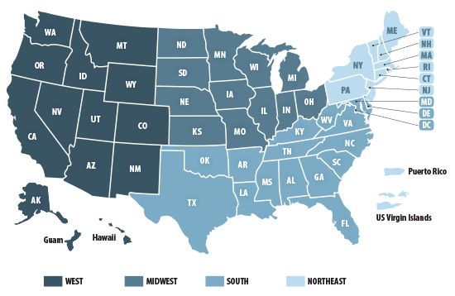
Variables

Slide 6
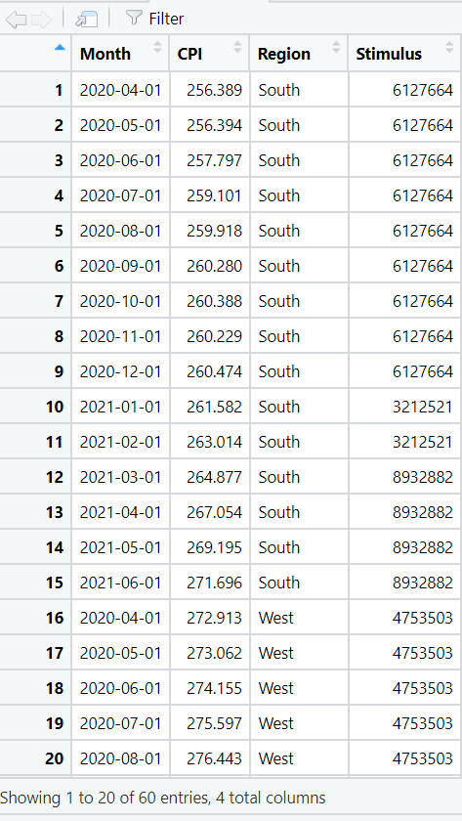
Data
Unbale to fund amount of monthly Stimulus for each state
CPI is not available for each states

